Slide 1
Introduction to design patterns
Hoanh Tran

Slide 2
Hoanh Tran (hoanh_tran@yahoo.com)
Enterprise Architect UML Model and slides download
https://github.com/h-t-tran/DesignPattern
http://www.slideshare.net/hoanhtran/design-pattern-presentation-36048254

Slide 3
agenda
Overview
Abstract Factory Pattern
State Pattern
Strategy Pattern
Null Object Pattern
Template Method Pattern

Slide 4
What is design pattern
Formal Definition:
Each pattern describes a problem that occurs over and over again in our environment, and then describes the core of the solution to that problem, in such a way that you can use this solution a million times over, without ever doing it the same way twice. — Christopher Alexander from GoF (Eric Gamma, Richard Helm, Ralph Johnson, John Vlissides) book.
Informal Definition:
A set of heuristics, idioms, guidelines and rules used when designing software.
Formalize communication between SW designers.

Slide 5
Common design pattern references
23 classic design patterns from Gang of Four book.
Discusses the common patterns such as singleton, factory, decorator, state, etc. Focuses at class level.
Pattern Oriented Software Architecture (POSA) (16 patterns)
Discusses higher level patterns such as MVC, Publish-Subscriber, Pipes & Filters, etc. Focuses at component level.
Core J2EE Patterns(21 patterns)
Covers web domain patterns such as Data Access Object (DAO), Data Transfer Object (DTO), Front Controller, etc.

Slide 6
design patterns categories
Creational Patterns - abstract the instantiation process by reducing the number of “new” in the client code.
Structural Patterns – describe how to use inheritance, composition to group classes and interfaces to form larger structures.
Behavior Patterns – describes the communication between objects. It uses inheritance to distribute behavior between classes.

Slide 7
design patterns categories
Creational Patterns:
Singleton – enforces a single point of access to a resource
* Abstract Factory – abstraction to create a families of object without having to know the concrete types.
Factory Method – similar to Abstract Factory, but it is to create a single object.
* Will be covered in detail

Slide 8
design patterns categories
Structural Patterns:
Façade – abstract a complex subsystem from the user by providing a simplified set of APIs.
Decorator – using composition (instead of subclassing) to add new behavior to a class.
Adapter – create a new interface to an existing class that you can’t modified so it can be used by your app.
Proxy – create a placeholder to an existing class with the same interface. Typically used to control access to a remote object.
* Will be covered in detail

Slide 9
design patterns categories
Behavior Patterns:
Command– encapsulate each request as a command object which knows how to carry out its operation.
Iterator – allows client to access a collection of objects sequentially w/out having to knowing the underlying representation.
* State – uses to represent a state machine.
* Strategy – provides a common interface for a group of complex algorithms to a client. We can switch the algorithm without affecting client code.
* Template Method – provides a recipe to perform a complex operation, but defer some steps to subclasses.
* Will be covered in detail

Slide 10
Abstract Factory

Slide 11
Abstract Factory
Motivation
Provides an abstraction when creating different families of objects.
Reduces if-then-else or switch statements.
Example
“Home Building” software that supports different types of home (cheap home, tract home, luxury home).
A home has several features such as window, door, floor.
Let’s assume the software has 2 operations build() and print().
3 families (cheap, tract, luxury)
Each family has 3 objects (window, door, floor)

Slide 12
Abstract Factory (cont)
Not-so-elegant implementation
Class HomeBuildingApp
{
void build()
{
switch( homeType)
{
case “cheap”:
var window = new CheapWindow();
var door = new CheapDoor();
var floor = new CheapFloor();
case “luxury”:
var window = new LuxuryWindow();
var door = new LuxuryDoor();
var floor = new LuxuryFloor();
case “tract”:
var window = new TractWindow();
var door = new TractDoor();
var floor = new TractFloor();
/* use the window, door and floor to build the house and display on the screen*/
}
}

Slide 13
Abstract Factory (cont)
void print()
{
switch( homeType)
{
case “cheap”:
var window = new CheapWindow();
var door = new CheapDoor();
var floor = new CheapFloor();
case “luxury”:
var window = new LuxuryWindow();
var door = new LuxuryDoor();
var floor = new LuxuryFloor();
case “tract”:
var window = new TractWindow();
var door = new TractDoor();
var floor = new TractFloor();
/* layout the window, door and floor then print */
}
}

Slide 14
Abstract Factory (cont)
Pitfalls
If we add a new home type (eg custom home), need to add new “case” in two places.
Both build() and print() know about concrete types instead of working with abstraction.

Slide 15
Abstract Factory (cont) – Revise design

Slide 16
Abstract Factory (cont)

Slide 17
Abstract Factory (cont)
Class HomeBuildingApp
{
private HomeWidgetFactory _factory = new
LuxuryHomeWidgetFactory();
void build()
{
var door = _factory.createDoor();
var wnd= _factory.createWindow();
var floor = _factory.createFloor();
/* use the window, door and floor to build the house and display on the screen*/
}
void print()
{
var door = _factory.createDoor();
var wnd= _factory.createWindow();
var floor = _factory.createFloor();
/* create the layout using the door, window and floor, then print*/
}

Slide 18
Abstract Factory (cont)
Improvement design
HomeBuildingApp does not know the concrete type of window, floor and door. It works with abstraction.
A new home type (eg Custom home) can be added without modifying HomeBuildingApp.

Slide 19
State Pattern

Slide 20
State pattern
Motivation
Eliminate huge if/else or switch statement when processing states.
Eliminate monolithic class.
Decouple state logic into it’s own class.
Improve understandability of the class.

Slide 21
State pattern

Slide 22
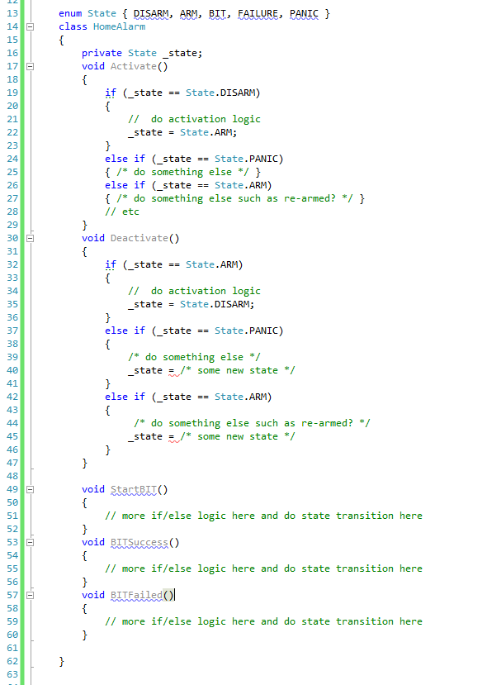
State pattern
Explosion of if/else statement as # of events and state increase.
Difficult to follow logic.

Slide 23
State pattern

Slide 24
State pattern

Slide 25
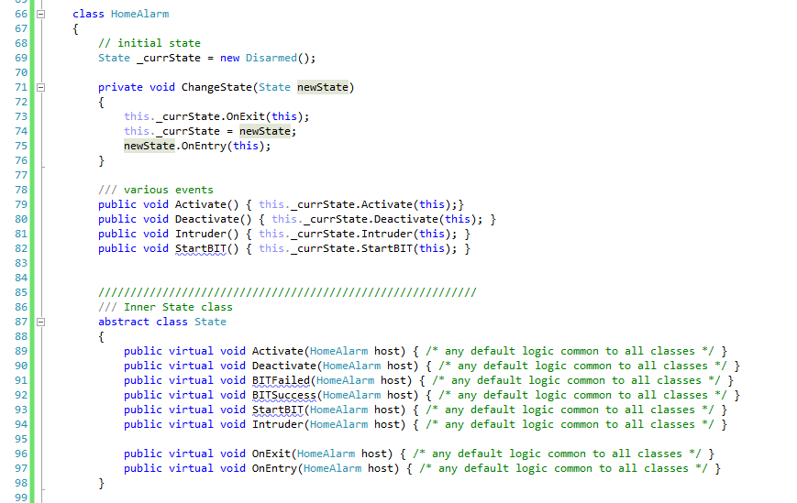
State pattern
Client-facing interface/API.
Client unaware of internal state machine

Slide 26
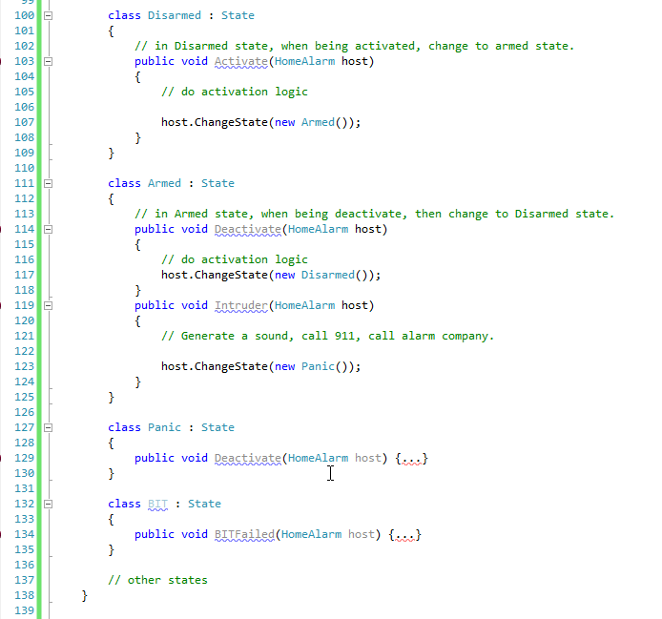
State pattern

Slide 27
State pattern
Advantages
New behavior and state transition can be added to a state without touching other states.
Reduces accidentally introduce new bug as in monolithic approach.
Unit test each state independently.
Allow multiple developers to work on the same state machine simultaneously without clobbering each other’s work.
Improve unit-testability.

Slide 28
Null object Pattern

Slide 29
Null Object Pattern
Motivation
Eliminates the need for NULL check.

Slide 30
Null Object Pattern
This is the “null object” implementation.

Slide 31
Null Object Pattern (w/out using null object(
Class FTP
{
ICommunicationDevice dev = NULL;
void CreateConnection( ICommunicationDevice dev )
{
this.dev = dev;
}
void OpenSession()
{
if( dev != NULL)
dev.Open();
// other logic that may contain check for dev != NULL
}
void CloseSession()
{
if( dev != NULL)
dev.Close();
// other logic
}
// other method that need to have if(dev != NULL)

Slide 32
void Transfer()
{
if( dev != NULL)
dev.Send();
// other logic
// some logic that uses the dev
if( dev != NULL)
dev.XXXXX();
}
…..
}
Proliferation of NULL checks.
Imagine if FTP class has 10+ methods. Each method has a few “if (dev != NULL)” checks.

Slide 33
Null Object Pattern (using null object pattern)
Interface ICommunicationDevice
{
void Open() = 0;
void Close() = 0;
void Send() = 0;
void Receive() = 0;
void GetErrorStatus() = 0;
}
// Null Object Implementation as either NOOP or perform some “default” behavior.
Class NullDevice : ICommunicationDevice
{
void Open() { /* no op */ }
void Close() { /* no op */ }
void Send() { /* no op */ }
void Receive() { /* no op */ }
void GetErrorStatus() { /* no op */ }
}

Slide 34
Null Object Pattern
Class FTP
{
ICommunicationDevice dev = new NullDevice(); // ensure dev is always non-null
void CreateConnection( ICommunicationDevice dev )
{
if( dev != null )
this.dev = dev;
}
void OpenSession()
{
if( dev != NULL)
dev.Open();
// we can safely remove all check of dev != NULL
}
void CloseSession()
{
if( dev != NULL)
dev.Close();
// other logic
}

Slide 35
Null Object Pattern
void Transfer()
{
if( dev != NULL)
dev.Send();
// other logic
// some logic that uses the dev
if( dev != NULL)
dev.XXXXX();
}
…..
}

Slide 36
strategy Pattern

Slide 37
Strategy Pattern
Motivation
Allows an object to vary its behavior at runtime using different strategy.
Reduces if/else or switch/case statements.

Slide 38
Strategy Pattern

Slide 39
Strategy Pattern
FTP depends on3 different behaviors - compression, encryption and transmission.
Each behavior has 2 different strategies.
FTP depends only on the interface of each of behavior (ICompression, IEncrypt, ITransmission)
We can inject different strategy of each behavior at runtime.

Slide 40
Strategy Pattern
Not-so-elegant implementation
class FTP {
void SendFile( string filename )
{
if( using AES256)
_encryptor = new AES256Encryptor()
else if(using DES )
_encryptor = new DESEncryptor()
etc.
if( using LZW)
_compressor = new LZWCompressor()
else if(using Looseless)
_compressor = new HomegrownCompressor()
etc.
if( using TCP)
_sender = new TCPTransmission()
else if(using Serial)
_sender = new SerialTransmission()
// Now use _encryptor, _compressor and _sender to encrypt, compress and transmit the file.
FTP class knows about the concrete type of the various “strategies”.
New strategy result in updating FTP class

Slide 41
Strategy Pattern
Class FTP
{
ICompression _compressor
IEncryptor _encryptor;
ITransmission _sender;
void SendFile()
{
this._encryptor.Encrypt( file )
this._compressor.Compress( file )
this._sender.Transmit ( file )
}
void SetCompressionStrategy (Icompression compress) { this._compressor = compress }
void SetEncryptionStrategy (IEncryption en) { this._encryptor = en}
void SetTransmissionStrategy (ITranmission tr) { this._sender = tr}
…..
}
Injection points of the strategies.
FTP class only works with interfaces

Slide 42
Strategy Pattern
Strategy Pattern is typically used in conjunction with IoC (Inversion of Control) and Dependency Injection.
Separate complex algorithm from the client.

Slide 43
Template method Pattern

Slide 44
Template Pattern
Motivation
Provide a skeleton or recipe for a workflow.
Let subclass specify the implementation detail.
Use in many re-useable frameworks.

Slide 45
Template Pattern
FTP Example.

Slide 46
Template Pattern

Slide 47
Template Pattern
Class FTP /* abstract class specifying the workflow */
{
public void TransmitFile() /* specify the skeleton for transmitting a file */
{
// step 1: open the file.
File f = open file;
// step 2: encrypt file
this._EncryptFile ( f )
// perform some post encryption check
// step 3: compress file
this._CompressFile ( f )
// perform some post compression check
// step 4: compress file
this._SendFileContent( f )
// perform some post send check
// step 5: resource cleanup
this._Cleanup( f )
// step 6: resource cleanup
close file.
}

Slide 48
Template Pattern
protected virtual void EncryptFile ( f )
{ // some default encryption algorithm }
protected virtual void ._CompressFile ( f )
{ // no op }
protected virtual void _SendFileContent( f )
{ // no op }
protected virtual void _Cleanup( f )
{ // no op }
}

Slide 49
Template Pattern
// use different compression and encryption to ensure fast
// and secure FTP. Override only necessary methods, otherwise use default behavior.
Class FastSecureFTP : FTP {
protected override void EncryptFile ( f )
{ /* use AES 256 */ }
protected override void _CompressFile ( f )
{ /* specify compression techinque eg LZW or PPMd */ }
protected override void _SendFileContent( f )
{ /* transmit over SSH or TCP */ }
protected override void _Cleanup( f )
{ /* cleanup ?? If not, no need to override */ }
}

Slide 50
Template & Strategy Pattern comparison
Strategy | Template Method
Behavior can vary at Runtime | Behavior is fixed
Allow user flexibility to configure an object behavior using different permutation | Proliferation of classes. One new class for each new combination.
Ex. Compression Options: LZW, HomeGrownCompression,
Looseless.
Encryption Options: AES, DES, HomeGrownEncryption
Transmission Option: TCP, Serial, SATCOM
Possible permutation = 3x3x3 = 27.

Slide 51
Template & Strategy Pattern comparison
Strategy
User can pick and choose from the 27 options to inject into FTP
object at runtime.
Template Method
Need to create 27 different classes derived from FTP class. Ex. AesLzwTcpFtp, AesHomegrownCompressionTcpFtp, etc)
More suitable if we want to enforce certain combinations.
Ex. Allow AES to be used with LZW and Serial (AesLzwSerialFtp)
Allow DES to be used with Looseless and TCP (DesLooslessTcpFtp).
Disallow other combinations.

Slide 52
Summary
Briefly discuss some GoF patterns.
Covered 5 popular patterns – Abstract Factory, Null Object, State, Strategy, Template Method.
Q & A

